Slide 1
An Architecture for Intelligent Trading
intelligent
trading
summit

Slide 2
Agenda
The Need for Intelligent Trading
The Challenges to Address
The Value of the Platform
Big Data in Motion and its Application to Trading
A Modern Architecture for Intelligent Trading
Wrap up and Q&A

Slide 3
Agenda
The Need for Intelligent Trading
The Challenges to Address
The Value of the Platform
Big Data in Motion and its Application to Trading
A Modern Architecture for Intelligent Trading
Wrap up and Q&A

Slide 4
“In the past 10 years, automated trading has risen from 5% to over 80% of all trades done each year. The ROI of intelligent automation on Wall Street cannot be computed – it’s worth billions and is a matter of survival.”
- Head of trading, top tier broker dealer

Slide 5
Agenda
The Need for Intelligent Trading
The Challenges to Address
The Value of the Platform
Big Data in Motion and its Application to Trading
A Modern Architecture for Intelligent Trading
Wrap up and Q&A

Slide 6


Slide 7
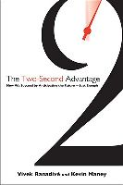
  “The ability to capture the right information at the right time and act on it preemptively for a competitive advantage” – that’s the Two-Second Advantage.
  – Vivek Ranadivé, TIBCO Founder and CEO

Slide 8
Agenda
The Need for Intelligent Trading
The Challenges to Address
The Value of the Platform
Big Data in Motion and its Application to Trading
A Modern Architecture for Intelligent Trading
Wrap up and Q&A

Slide 9
“Business value doesn’t come from building faster applications; it comes from building applications faster.”
- Head of algorithmic trading, top-tier broker dealer

Slide 10








A PLATFORM FOR INTELLIGENT OPERATIONS

Slide 11
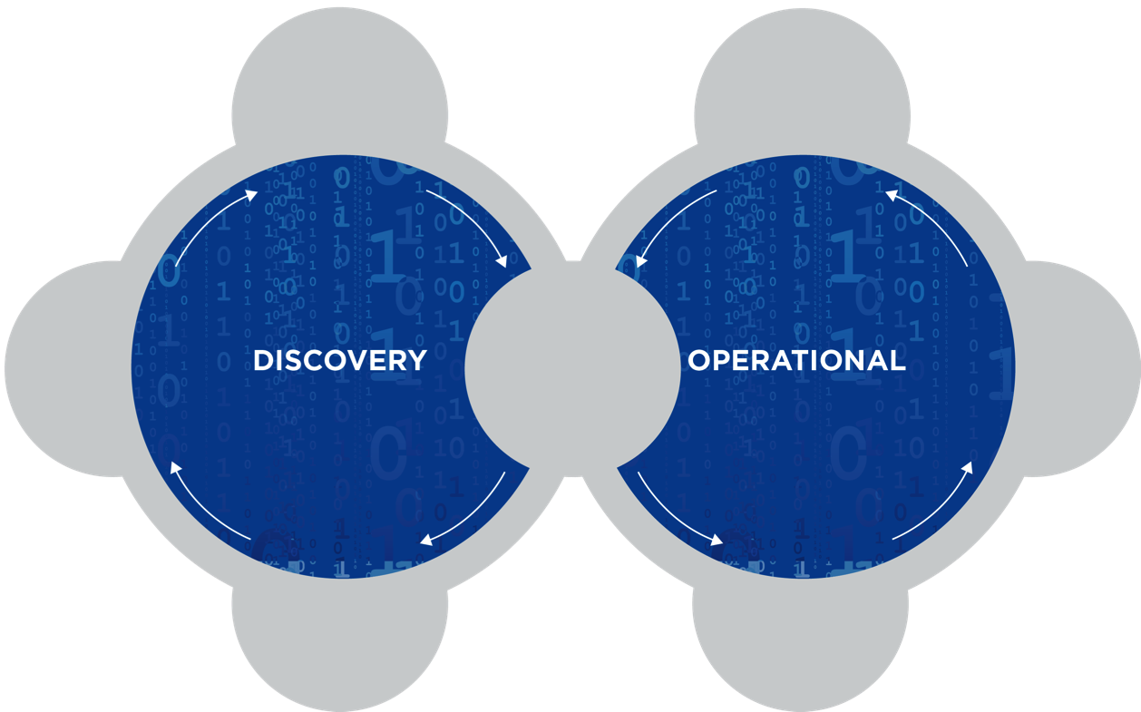




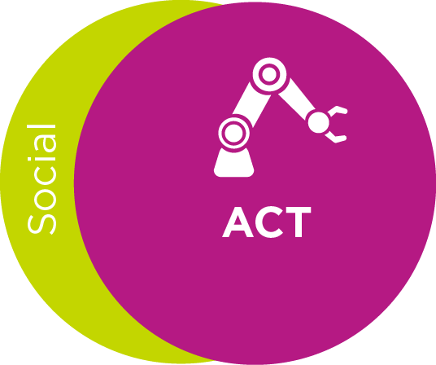



Event Driven Enterprise
Statistics & Data Mining
Streaming Real-Time Analytics
Low-Latency Messaging
Visual Analytics,
MDM
SOA, BPM, Social
Real-Time Model Execution
Log Management, NoSql, Enterprise DB
Rules & Inferencing

Slide 12
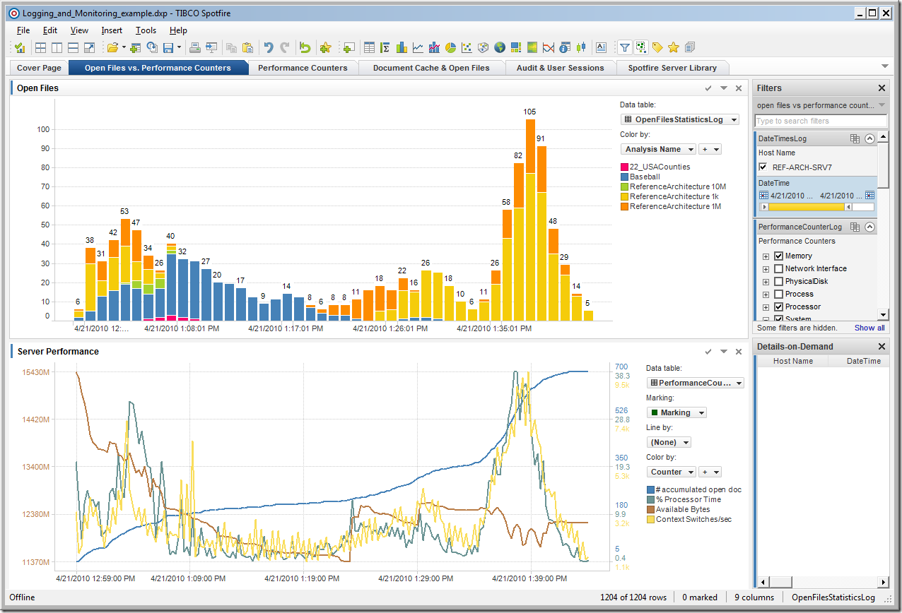
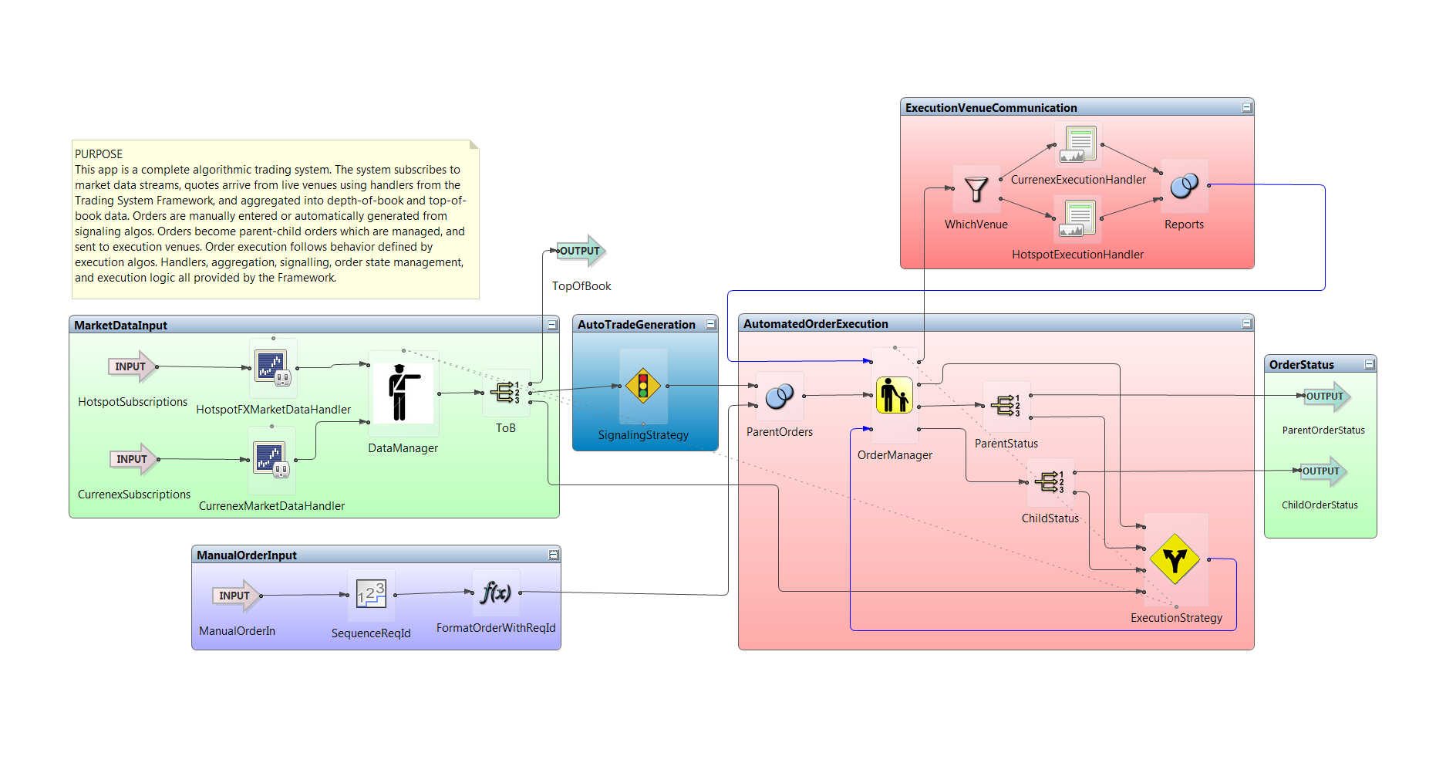
Analyze…Adjust…Deploy…Repeat
Adjust Automation Model
Adjust trading algorithm
Transaction cost too high
Trading strategy not making money
Deploy
Deploy
Event Processing
Correlate
Aggregate
Analyze
Analyze
Automate
Alert

Slide 13
Agenda
The Need for Intelligent Trading
The Challenges to Address
The Value of the Platform
Big Data in Motion and its Application to Trading
A Modern Architecture for Intelligent Trading
Wrap up and Q&A

Slide 14

BIG DATA

Slide 15
Agenda
The Need for Intelligent Trading
The Challenges to Address
The Value of the Platform
Big Data in Motion and its Application to Trading
A Modern Architecture for Intelligent Trading
Wrap up and Q&A

Slide 16
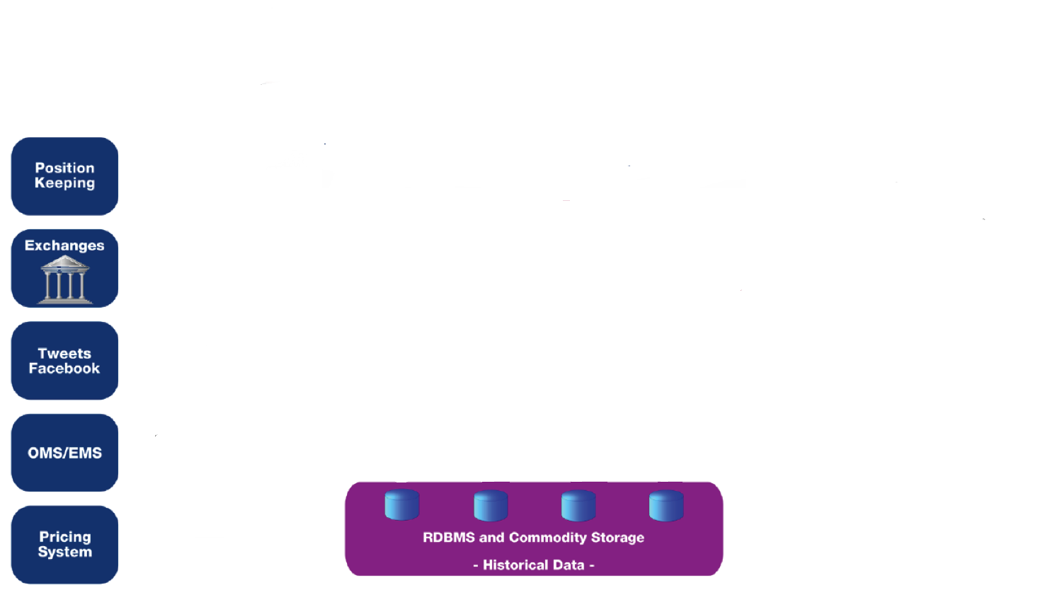
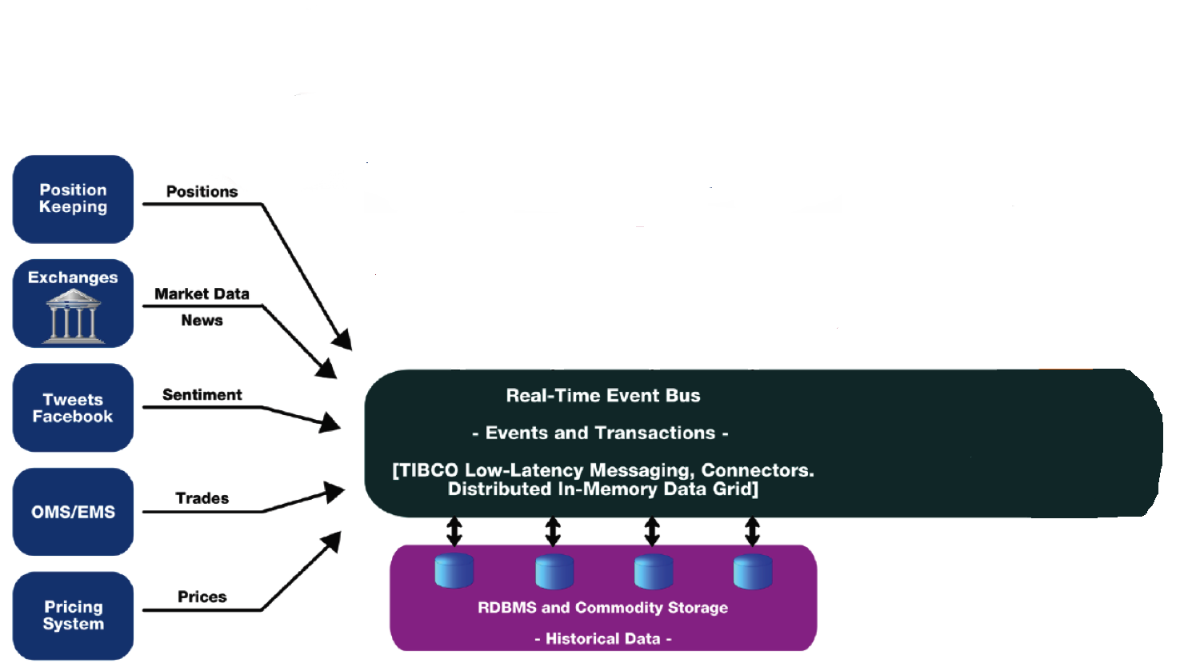
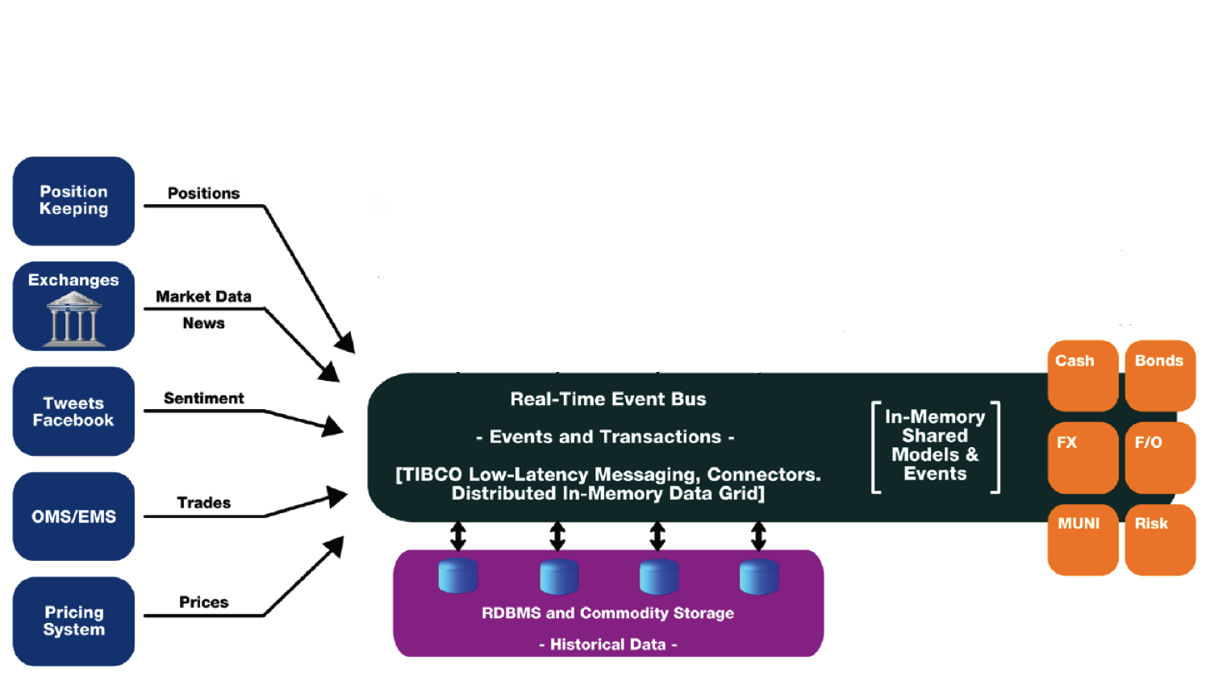
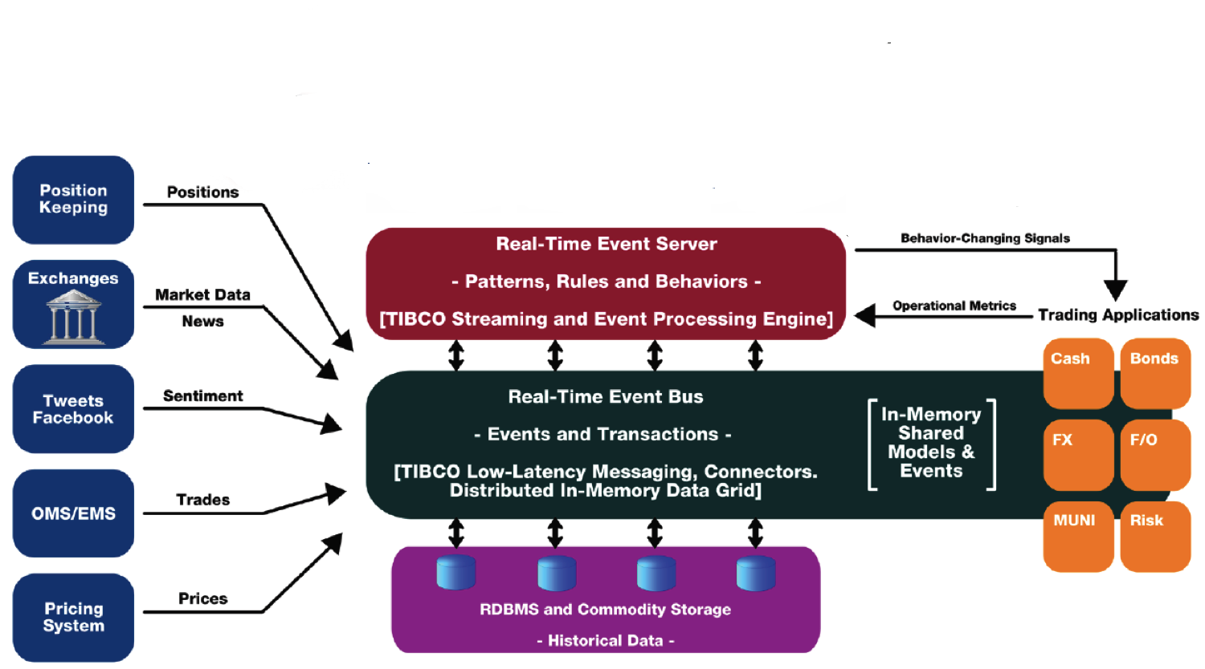
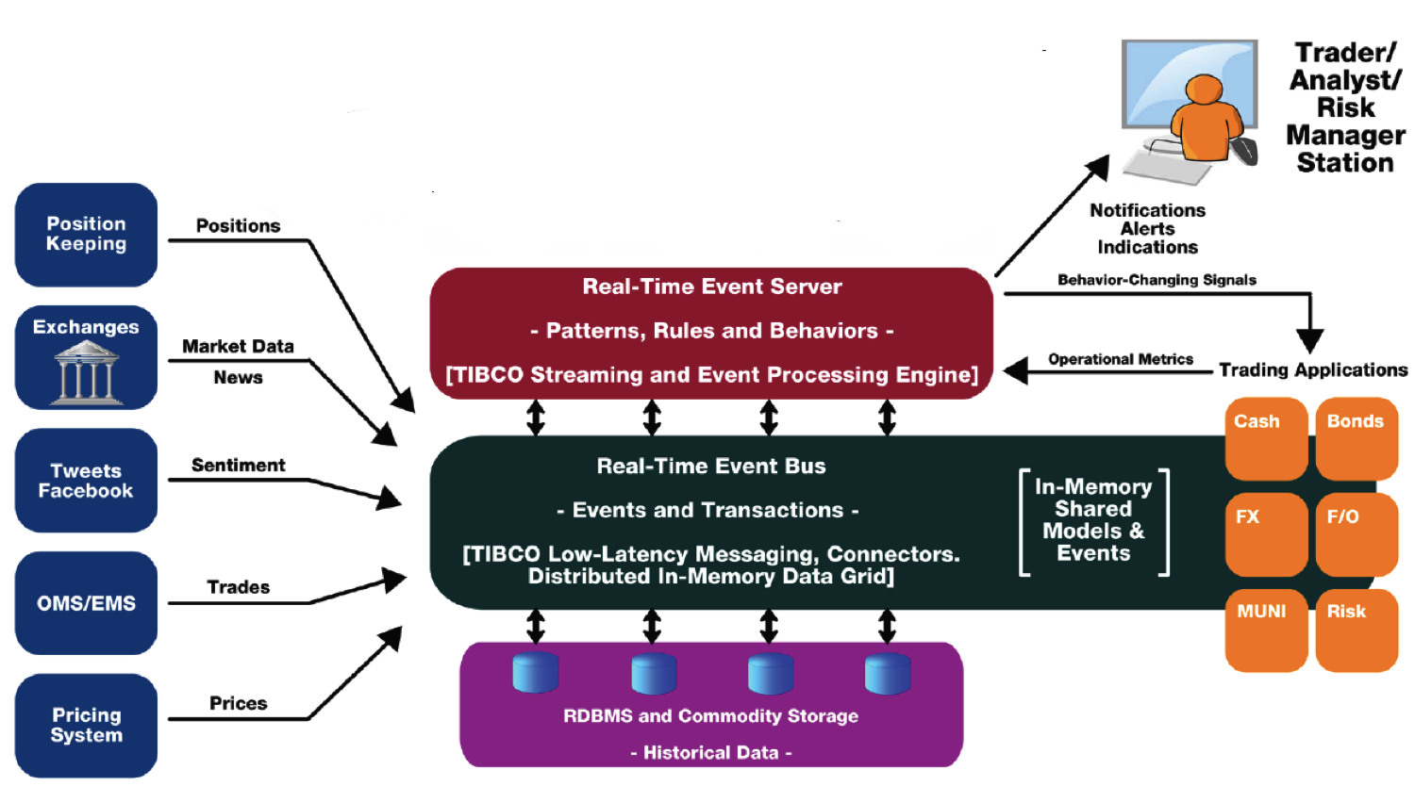
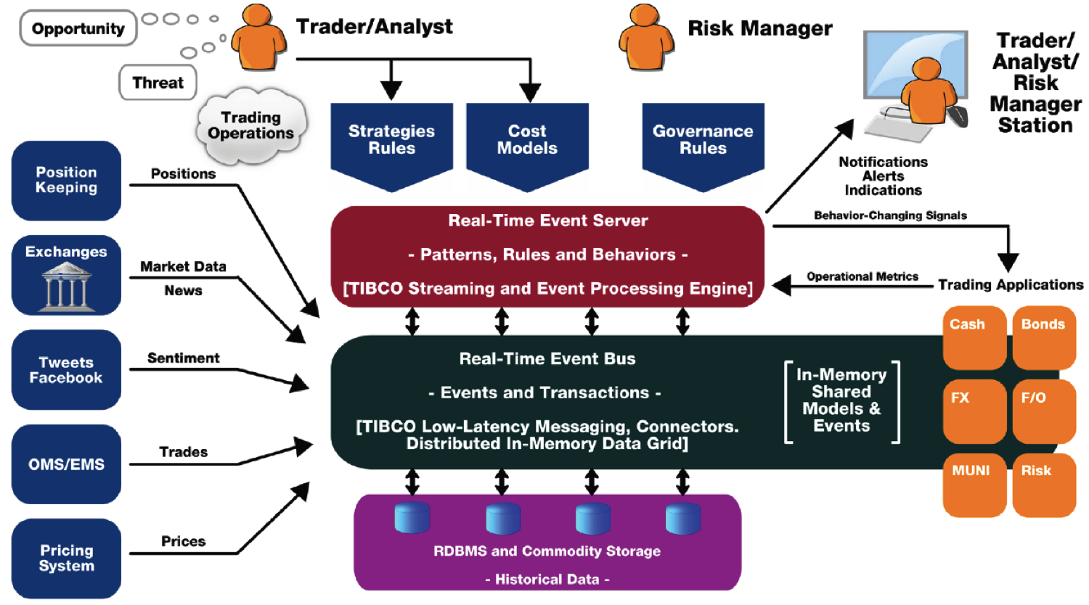

Slide 17

Case Study: Intelligent Algorithmic Trading
Situation: Wall Street Imperative to Deploy Algo Trading
  In the last 10 years, automated trade flow has gone from 5% to 80%
  Innovative algorithmic trading technology and time to market are critical to survival in the capital markets
Problem: How to Automate?
  Custom coding? Packaged applications? Event Processing?
  Streaming analytics are essential to effective algo trading
Solution: TIBCO for Algorithmic Trading
  With TIBCO, algorithms are developed 3-5X faster than if traditional technologies were used like databases or application servers
  Provides low latency event processing, aggregation, scale, and visualization
Result: Event Processing Provides Pure Competitive Advantage for Algo Trading
  Quants and IT communicate and build systems more quickly, with built-in performance, scalability, and connectivity.
“In three months we were up and trading, and we were the fastest auto quoter on the market.”
- Head of algorithmic trading, top-tier broker dealer

Slide 18
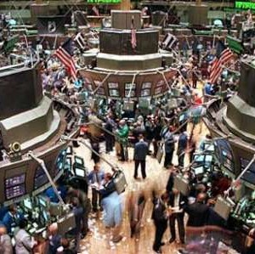




Reference Architecture: Automated Trading
Tick Store
MATLAB
Quants
Analytic
Trades
Analytic
Reuters, NYSE, etc.
Backtesting
Streaming Market Data
History
Automated Trades
Event Processing
Historical Analytics
Monitor
Algorithms
Analytic
Event Analytics
Reuters, Twitter, etc.
HFT
Real-time Risk
Real-Time Analytics
Real-Time Analytics
Streaming news, social media, etc.
Traders
Execution Consulting Services
Risk Management
Quantitative Research

Slide 19
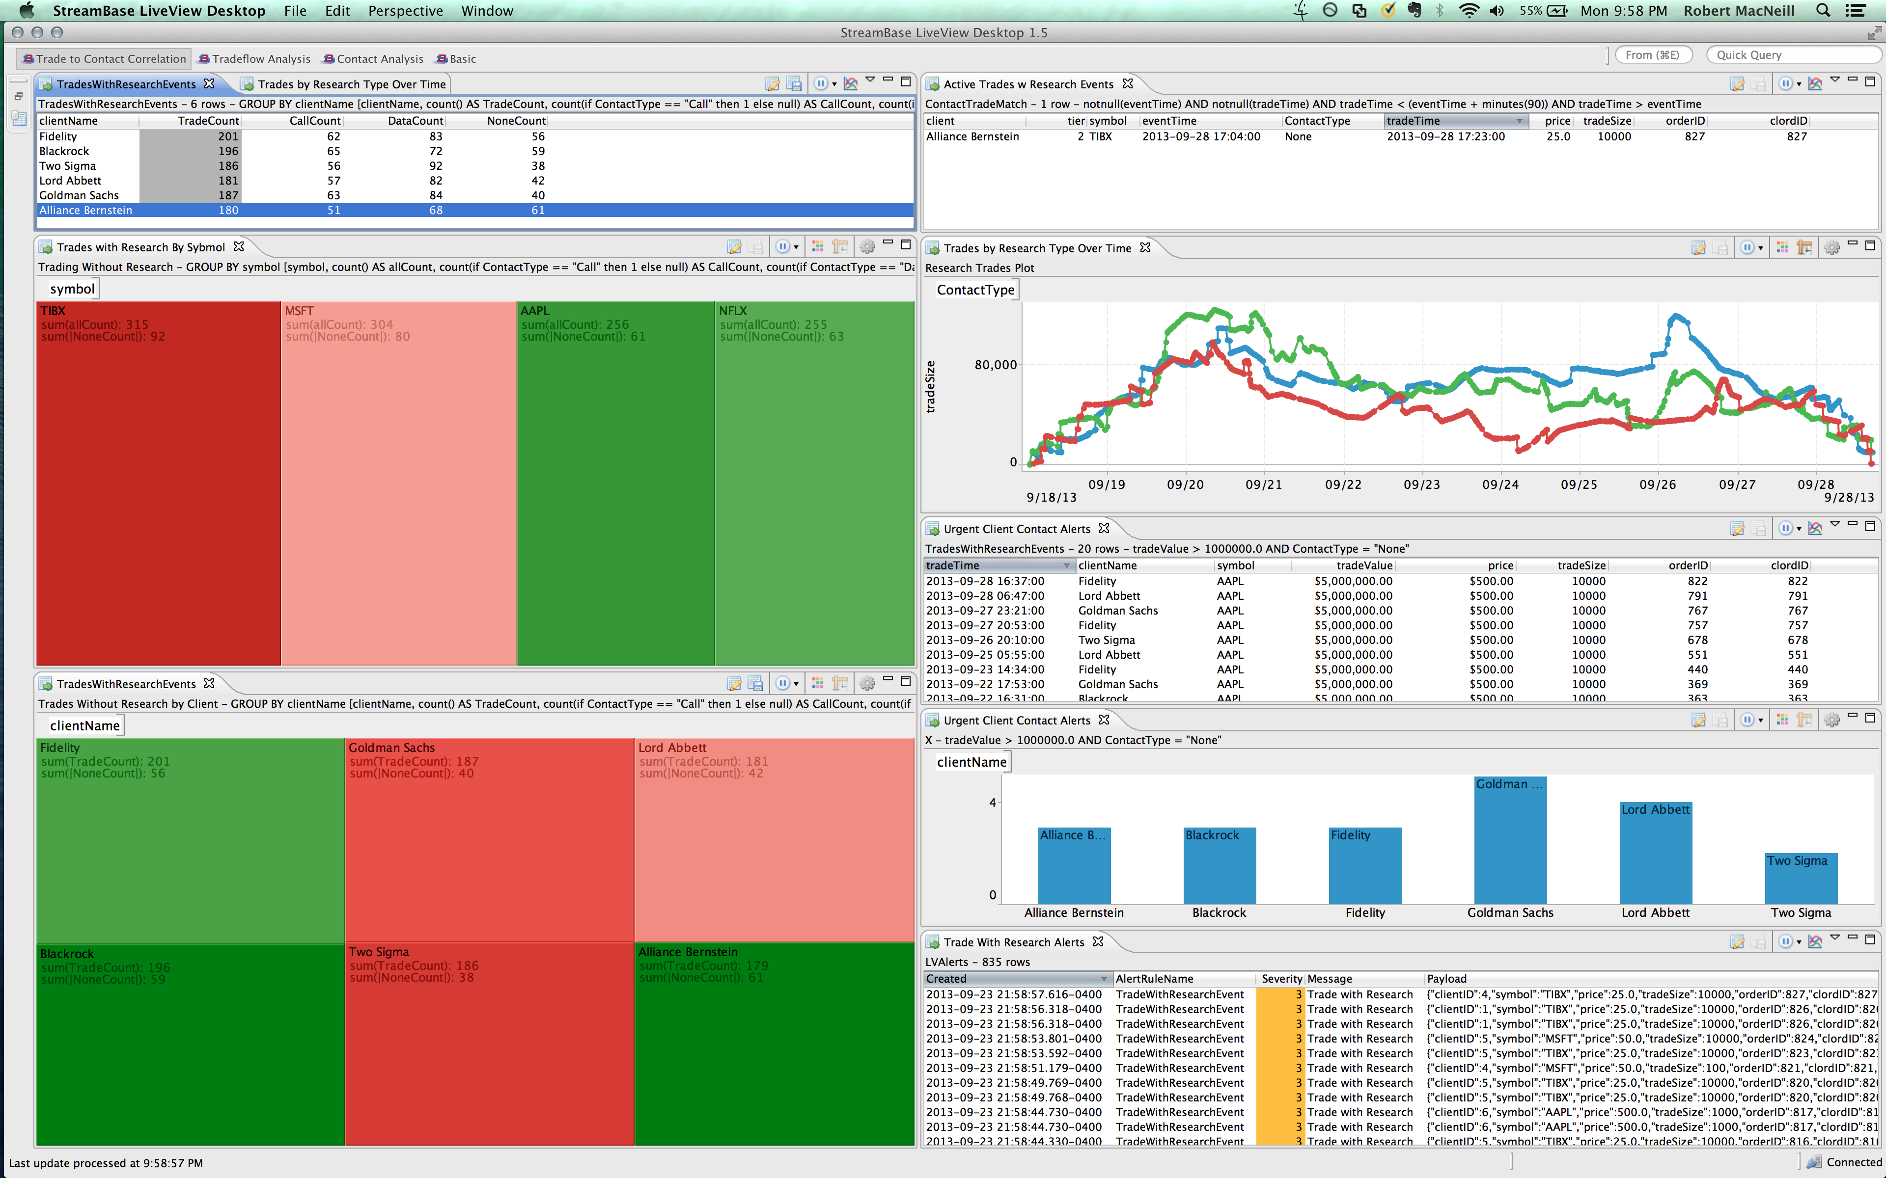
Real-Time Monitoring & Fraud Detection
Situation: Moving Data Requires Event-Driven Monitoring
  Streaming machine-generated data overpowers existing end-of-day analytics and reporting infrastructure
Problem: Existing Commercial Products Not Real-Time
  Existing products are designed for ETL-style capture and analytics, not for streaming data
Solution: Event-Driven Monitoring with StreamBase
  Event Processing for event stream aggregation, correlation, and action
  LiveView for monitoring
  Integration with Hadoop and streaming machine-generated data
Impact: Market Disruption, First Mover Advantage
  Firms that are first to market with real-time monitoring and fraud detection capture a distinctive advantage in the market and save millions due to electronic-induced outages and fraud.
“Event-driven monitoring and fraud detection make it easy for us to whittle 100 million trading events down to the few that matter and ACT in real-time.”
- Managing Director, Global Brokerage

Slide 20


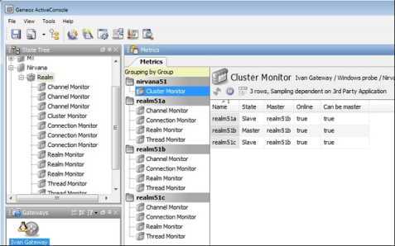
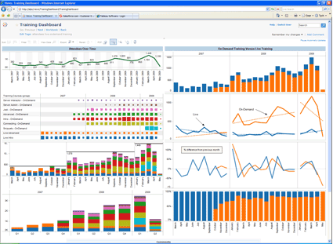
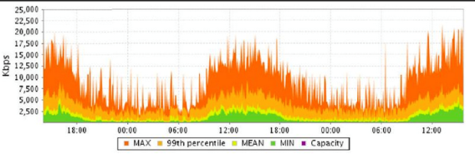
Reference Architecture: Monitoring & Fraud Detection
Events
Real-Time Analytics
Real-Time Visualization
Events
Temporal Correlation
Events
Stream Analysis
Events
Alerting
Events
Real-time Data Aggregation
Transactions, machine data
Event Processing
Application Monitoring
System Latency Monitoring
Analytics
Notes:
Application monitoring is usually a system like ITRS; System Latency Monitoring often a corvil. Analytics by Spotfire!

Slide 21
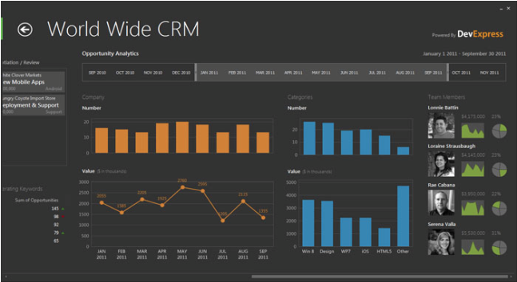
Intelligent Price Discovery in Asset Management
Situation: Major Asset Manager Needs Better and Faster Insight for Price Discovery
  Which trades are slipping? How close to target are we for participation rates? How can we adjust our trading in the market now?
Problem: How Make Informed Real-Time Decisions?
  Need real-time and historical trading analytics to put intraday trading strategy adjustments in the proper context
Solution: TIBCO StreamBase, LiveView, and Spotfire
  Firm deployed visualization and analytics for traders & portfolio managers to assess real-time and historical trade performance at once.
Impact: Improved Intraday Adaptability of Trading Strategies
  Solution helps allow traders and PM’s understand where their trade performance is going, and adjust trading strategies during the day
“We can analyze everything that impacts trade performance, and adjust to it on the fly.”
- Head of IT, Asset Management

Slide 22

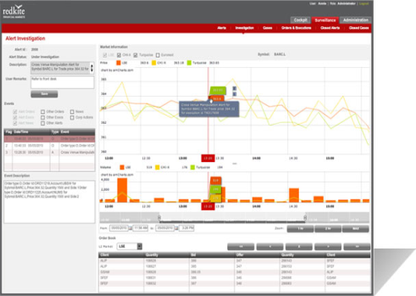




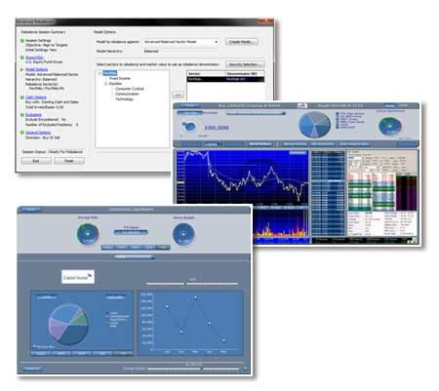
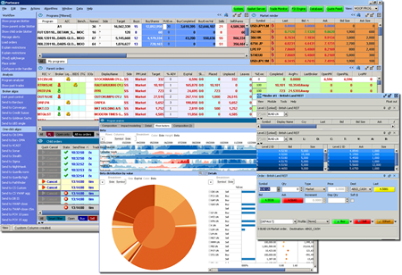
Reference Architecture: Intelligent Price Discovery
FIX
Event Processing
.NET GUI
Trading Analytics
FIX
Proprietary .NET User Interface
MQ
Real-Time Analytics
Traders & Portfolio Managers
DBMS
Aggregation
Alerts
OMS
EMS
Historical Analytics

Slide 23
Agenda
The Need for Intelligent Trading
The Challenges to Address
The Value of the Platform
Big Data in Motion and its Application to Trading
A Modern Architecture for Intelligent Trading
Wrap up and Q&A

Slide 24


Slide 25
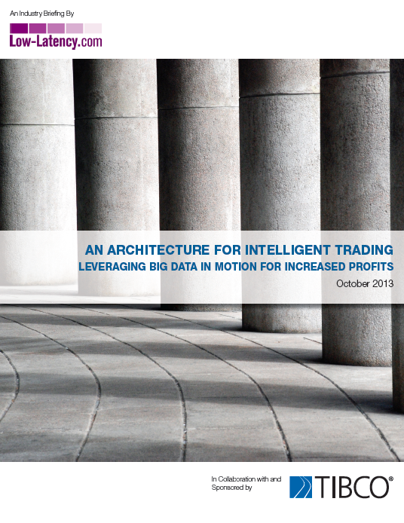
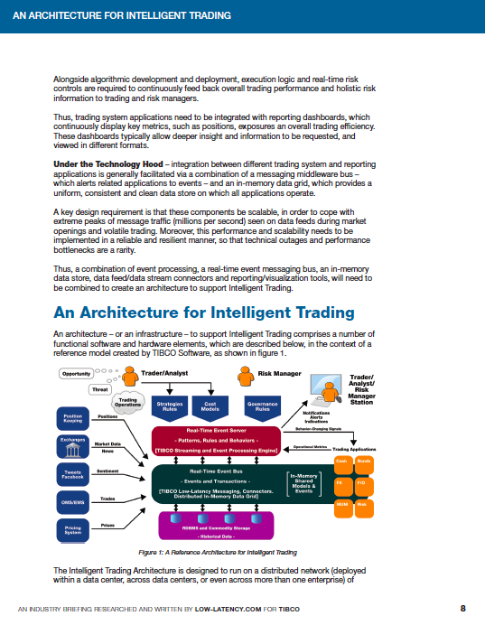

Learn More at the TIBCO Booth
White Paper: “An Architecture for Intelligent Trading”

Slide 26
Thank You
Thank You
Alessandro Petroni
TIBCO Software
apetroni@tibco.com
intelligent
trading
summit

